Slide 1

MACHINE LEARNING
IN
AI
ARTIFICIAL INTELLIGENCE

Slide 2
Topics :
What is AI ?
What is ML ?
How does Machine Learning Works ?
Difference between AI, ML, DL.
Application of AI & ML.
Types of Machine Learning
- Supervised Machine Learning
- Unsupervised Machine Learning
- Reinforcement Machine Learning

Slide 3
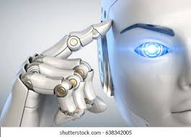
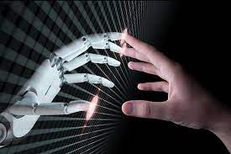
ARTIFICIAL INTELLIGENCE (AI) :
Artificial Intelligence is composed of 2 words :
1) Artificial : Man Made
2) Intelligence : Thinking Power
Means, A manmade thinking power.
AI is a technique of getting machines to work and behave like human.
The term
AI was first coined by “John McCarthy” in the year 1956.
Examples of AI :
Self Driving Cars
Face Detection and Recognition

Slide 4
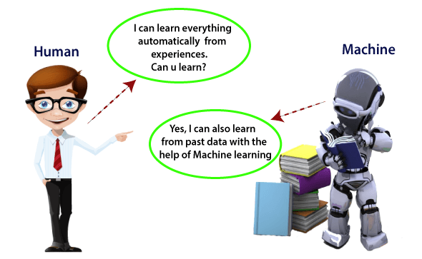
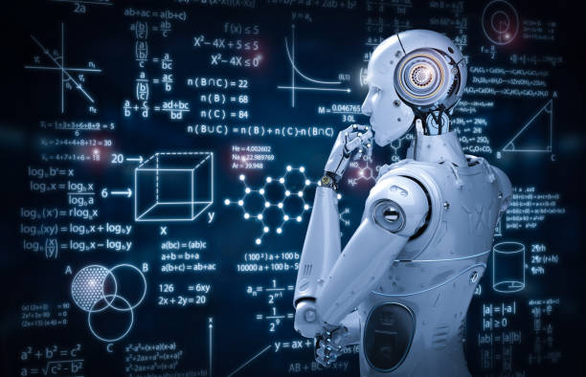
Machine Learning (ML) :
Machine Learning enables a machine to automatically learn from data,
improve performance from experiences, & predict things without being
explicitely programmed to carry out certain tasks.
In the year 1959 the term ML was coined by “Arthur Samuel”
Examples of ML :
Medical Diagnosis
Image Recognition

Slide 5
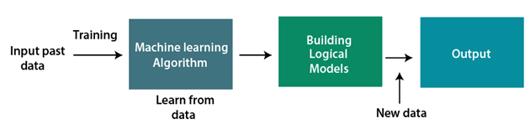
How Does Machine Learning Works ?
A Machine Learning system learns from historical data, builds the prediction models, and whenever it
receives new data, predicts the output for it. The accuracy of predicted output depends upon the amount
of data, as the huge amount of data helps to build a better model which predicts the output more accurately.

Slide 6
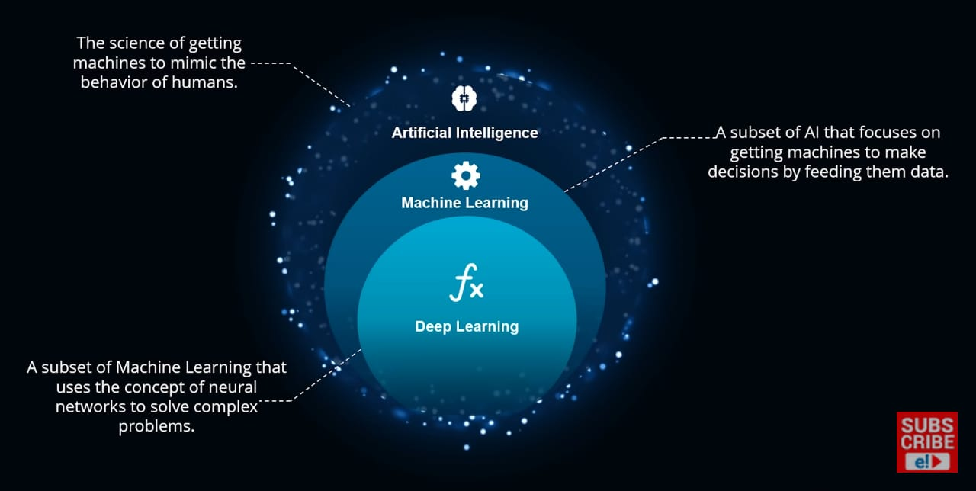
Difference Between AI, ML & DL:

Slide 7
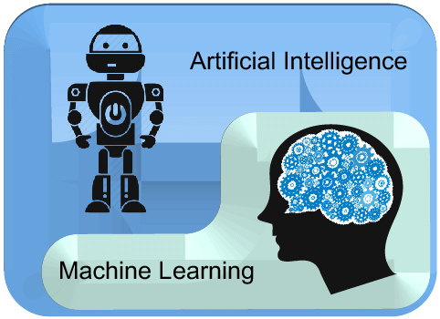
ARTIFICIAL INTELLIGENCE | MACHINE LEARNING
Artificial intelligence is a technology which enables a machine to simulate human behavior. | Machine learning is a subset of AI which allows a machine to automatically learn from past data without programming explicitly.
In AI, we make intelligent systems to perform any task like a human. | In ML, we teach machines with data to perform a particular task and give an accurate result.
Machine learning and deep learning are the two main subsets of AI. | Deep learning is a main subset of machine learning.
AI has a very wide range of scope. | Machine learning has a limited scope.
AI is working to create an intelligent system which can perform various complex tasks. | Machine learning is working to create machines that can perform only those specific tasks for which they are trained.
On the basis of capabilities, AI can be divided into three types, which are, Weak AI, General AI, and Strong AI. | Machine learning can also be divided into mainly three types that are Supervised learning, Unsupervised learning, and Reinforcement learning.

Slide 8
Applications of AI :
Siri
Expert System
Online Game Playing
Intelligent Humanoid Robot
Applications of ML :
Online Recommender System
Google Search Algorithms
Facebook Auto Friend Tagging Suggestion

Slide 9
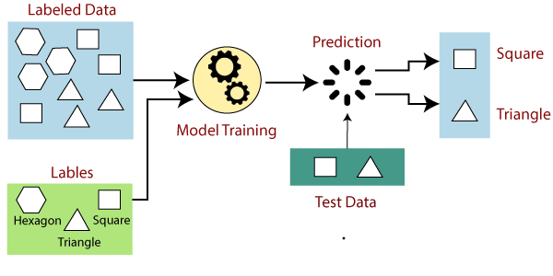
Types of Machine Learning
Supervised Machine Learning
- Supervised learning is the types of machine learning in which machines are trained using
well "labelled" training data, and on basis of that data, machines predict the output. The
labelled data means some input data is already tagged with the correct output.
- It can be categorized in Classification & Regression.

Slide 10
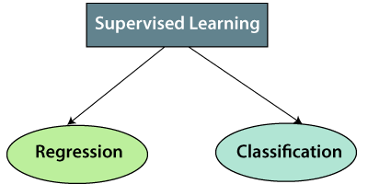

Slide 11
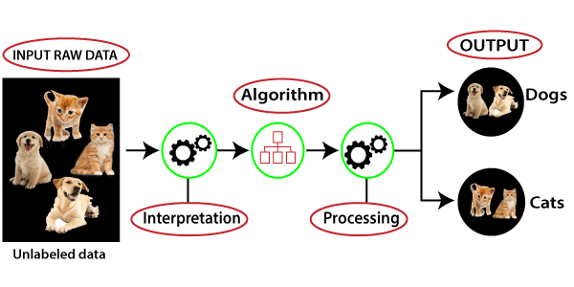
Unsupervised Machine Learning :
- As the name suggests, unsupervised learning is a machine learning technique in which models are not
supervised using training dataset. Instead, models itself find the hidden patterns and insights from the given
data. It can be compared to learning which takes place in the human brain while learning new things.
- It can be classified in Clustering & Association.

Slide 12
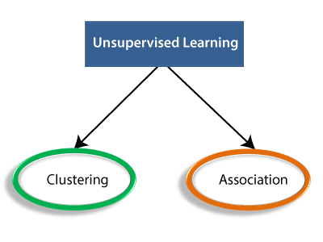

Slide 13
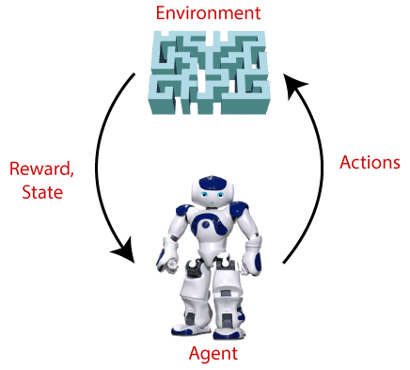
Reinforcement Learning :
Reinforcement Learning is a feedback-based Machine learning technique in which an agent learns to behave
in an environment by performing the actions and seeing the results of actions. For each good action, the
agent gets positive feedback, and for each bad action, the agent gets negative feedback or penalty.

Slide 14
Thank You !

